Slide 1


Machine Learning Driven Predictive Quality Analytics
Team - The Bug Stops Here
June 11, 2019

Slide 2

Machine Learning(ML) Overview
Machine Learning is an application of Artificial intelligence (AI) that provides systems the ability to automatically learn and improve from experience without being explicitly programmed. Machine learning focuses on the development of computer programs that can access data and use it learn for themselves.
The process of learning begins with observations or data, such as examples, direct experience, or instruction, in order to look for patterns in data and make better decisions in the future based on the examples that we provide. The primary aim is to allow the computers learn automatically without human intervention or assistance and adjust actions accordingly.
Supervised machine learning algorithms
can apply what has been learned in the past to new data using labeled examples to predict future events
e.g- Linear/Logistic regression
Semi-Supervised machine learning algorithms
are chosen when the acquired labeled data requires skilled and relevant resources in order to train it / learn from it
e.g- Low density separation
Machine Learning Methods
Un-Supervised machine learning algorithms
are used when the information used to train is neither classified nor labeled
e.g- Clustering , K-Means
Reinforcement machine learning algorithms
are chosen when the acquired labeled data requires skilled and relevant resources in order to train it / learn from it

Slide 3








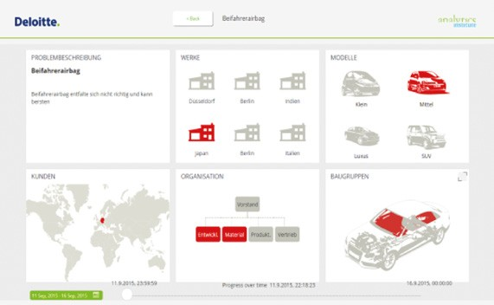


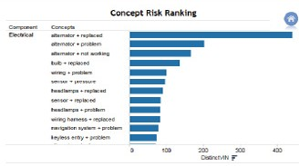
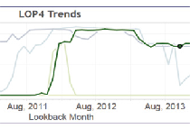
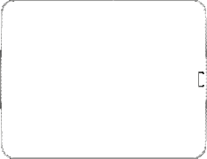

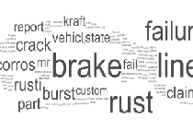
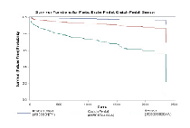



ML in SIT – Predictive Quality Analytics
Tracking and fixing bugs through automation and manual testing processes is becoming increasingly efficient. However efficient it may be to getting code shipped, the downside is, there’s no predictability to it. To cater this, there is a need to alter the landscape of System Integration Testing with Predictive Quality Analytics framework driven by Machine Learning methodologies.
As this technology matures, it will not only identify major bottlenecks, bug categories, and improvement areas; it will also suggest improvements based on analytics to majorly improve subsequent test runs and ultimately, code quality.
Predictive Quality Analytics – A three step approach
Correlate data sources –
The intelligent connection of
various pre-existing data sources
are the basis for gaining new insights
Perform advanced predictive/descriptive analytics –
A broad range of Machine Learning
techniques and analyses leads to
well- defined quality measures
Derive & implement quality measures
1
2
Perform advanced predictive/descriptive analytics
Correlate data sources
Theme discovery
Anomaly
detection
Examples
Concept extraction
Probability analysis
Quality Management Dashboard
Text clustering
Event history analysis
3
1
2
3
Derive & implement measures
Prioritization analysis
Risk-ranked Classification
Implementation of measures
7
5

Slide 4


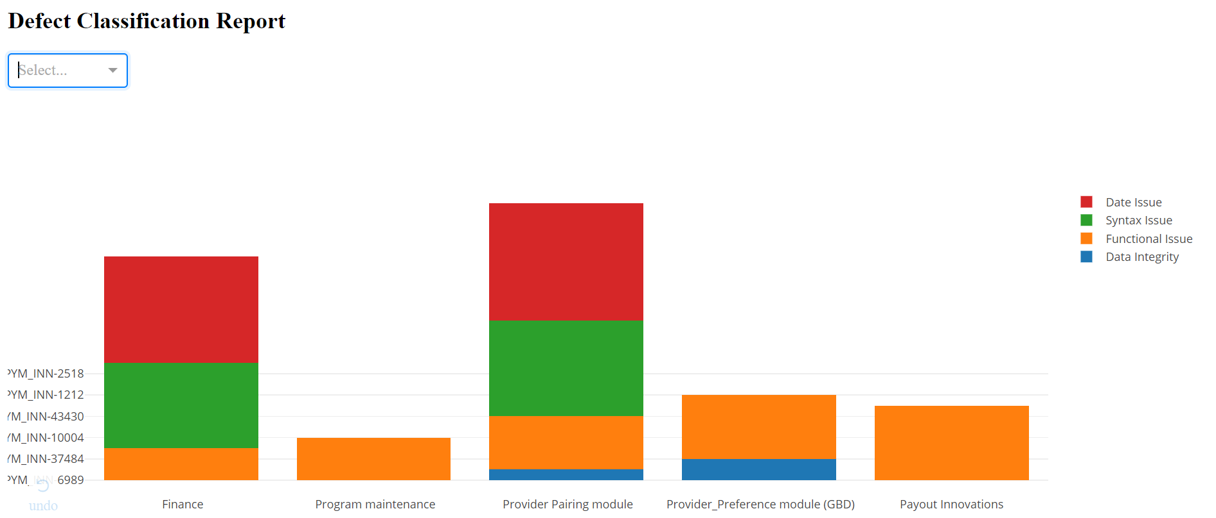
Defect Classification Mechanism
SIT Defect classification approach conceptual flow explained starting from data collection from test management tool to getting a Dashboard representation with all the statistics across projects
Model Execution & Defect
Classification
Data
collection
Visualization
Of
Results
Labelled defect dataset after feature selection is used for training below mentioned classification models-
Logistic Regression
Naïve Bayes
Support Vector Machine
Recurrent Neural Network
LSTM
XGBoost
The algorithm selects the best model based on accuracy.
Predicts the labels on the new data set
Release
Extract Data from test management application like JIRA
The extracted data contains 'Description’, ‘Project Name’ etc.
Perform feature selection to select those features which contribute most to your prediction variable or output in which we are interested in
The final results will be visualized as the distribution of defect types grouped by different projects .

Slide 5
Classification Methodologies Used
Support Vector Machine
Description-The objective of the support vector machine algorithm is to find the hyperplane that has the maximum margin in an N-dimensional
space(N — the number of features) that distinctly classifies the data points. Data points falling on either side of the hyperplane can be attributed
to different classes. Features used-Count Vectorizer, Tf-idf on tokens and characters (n grams) of the defect description
Recurrent Neural Network
Description-RNNs are designed to recognize a data's sequential characteristics and use patterns to classify a data point (defect) into a category
Features used-Layers created on batches of defect descriptions
LSTM – Long Short Term Memory
Description-LSTM networks are a type of RNN that uses special units in addition to standard units. LSTM units include a 'memory cell' that can
maintain information in memory for long periods of time. A set of gates is used to control when information enters the memory, when it's output
and when it's forgotten. Features used-Layers created on batches of defect descriptions
XGBoost
Description-Boosting Algorithm based on classification tree ensemble, the tree ensemble model is a set of classification and regression trees (CART).
Trees are grown one after another ,and attempts to reduce the misclassification rate are made in subsequent iterations.
Features used-Count Vectorizer, Tf-idf on tokens and characters (n grams) of the defect description
Logistic Regression
Description-Logistic regression is a statistical method for analyzing a dataset in which there are one or more independent variables that determine
an outcome. The outcome is measured with a categorical variable, defect labels in this case
Features Used-Count Vectorizer, Tf-idf on tokens(n grams) of the defect description
Naïve Bayes
Description-Uses Bayes Theorem to classify, works well for smaller dataset with the assumption of independence between attributes ,
Naive Bayes classifier assumes that the presence of a particular feature in a class is unrelated to the presence of any other feature
Features used-Count Vectorizer, Tf-idf on tokens(n grams) of the defect description

Slide 6
Classification Model Details
Support Vector Machine
Description-The objective of the support vector machine algorithm is to find the hyperplane that has the maximum margin in an N-dimensional space(N — the number of features) that distinctly classifies the data points. Data points falling on either side of the hyperplane can be attributed to different classes.
Features used-Count Vectorizer, Tf-idf on tokens and characters (n grams) of the defect description
Recurrent Neural Network
Description-RNNs are designed to recognize a data's sequential characteristics and use patterns to classify a data point (defect) into a category.
Features used-Layers created on batches of defect descriptions
LSTM
Description-LSTM networks are a type of RNN that uses special units in addition to standard units. LSTM units include a 'memory cell' that can maintain information in memory for long periods of time. A set of gates is used to control when information enters the memory, when it's output, and when it's forgotten.
Features used-Layers created on batches of defect descriptions
XGBoost
Description-Boosting Algorithm based on classification tree ensemble, the tree ensemble model is a set of classification and regression trees (CART). Trees are grown one after another ,and attempts to reduce the misclassification rate are made in subsequent iterations.
Features used-Count Vectorizer, Tf-idf on tokens and characters (n grams) of the defect description
Logistic Regression
Description-Logistic regression is a statistical method for analyzing a dataset in which there are one or more independent variables that determine an outcome. The outcome is measured with a categorical variable, defect labels in this case
Features Used-Count Vectorizer, Tf-idf on tokens(n grams) of the defect description
Naïve Bayes
Description-Uses Bayes Theorem to classify, works well for smaller dataset with the assumption of independence between attributes , Naive Bayes classifier assumes that the presence of a particular feature in a class is unrelated to the presence of any other feature
Features used-Count Vectorizer, Tf-idf on tokens(n grams) of the defect description

Slide 7




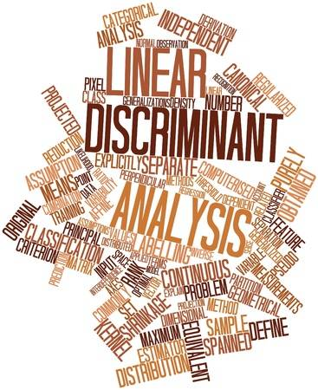
Timelines & Impact
Understanding the requirements
Outlining the scope
Data collection
Data Preprocessing & cleansing
Classification Model development , training & testing
Forecasting model development, training & testing
Component integration
End to End framework validation
Dashboard development for Classification & forecasting model output visualization
Final Demo
Timelines
Adds capability to project data and make proactive decisions
Making the SIT cycle more efficient with –
Increased quality
Cost Reduction
As the framework/engine matures through continuous learning, it delivers real-time insights that can improve test project outcomes on the go
Will provide continuous actionable intelligence to testing teams to bring improvements for each test runs
Easily integrates with existing SIT framework
Advantages & Impact
Tools & methodologies

Slide 8
Thank you

